Slide 1
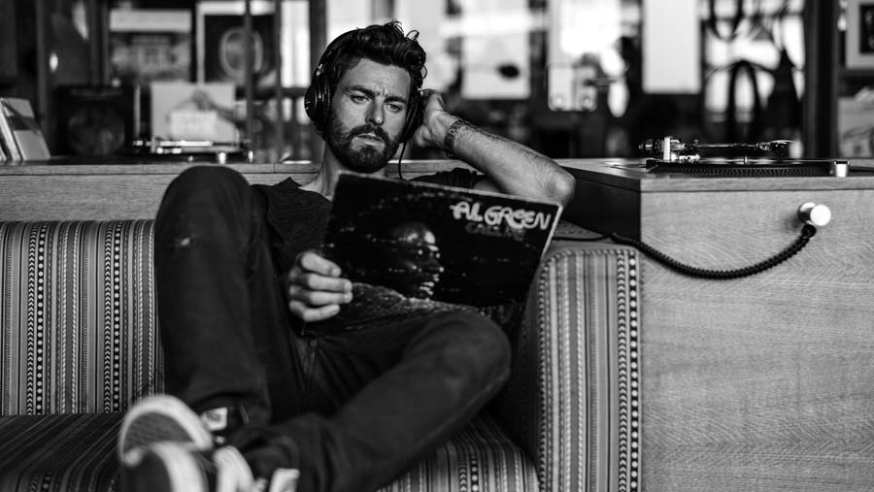
hafencity
April 2018

Slide 2
location & neighbourhood

Slide 3
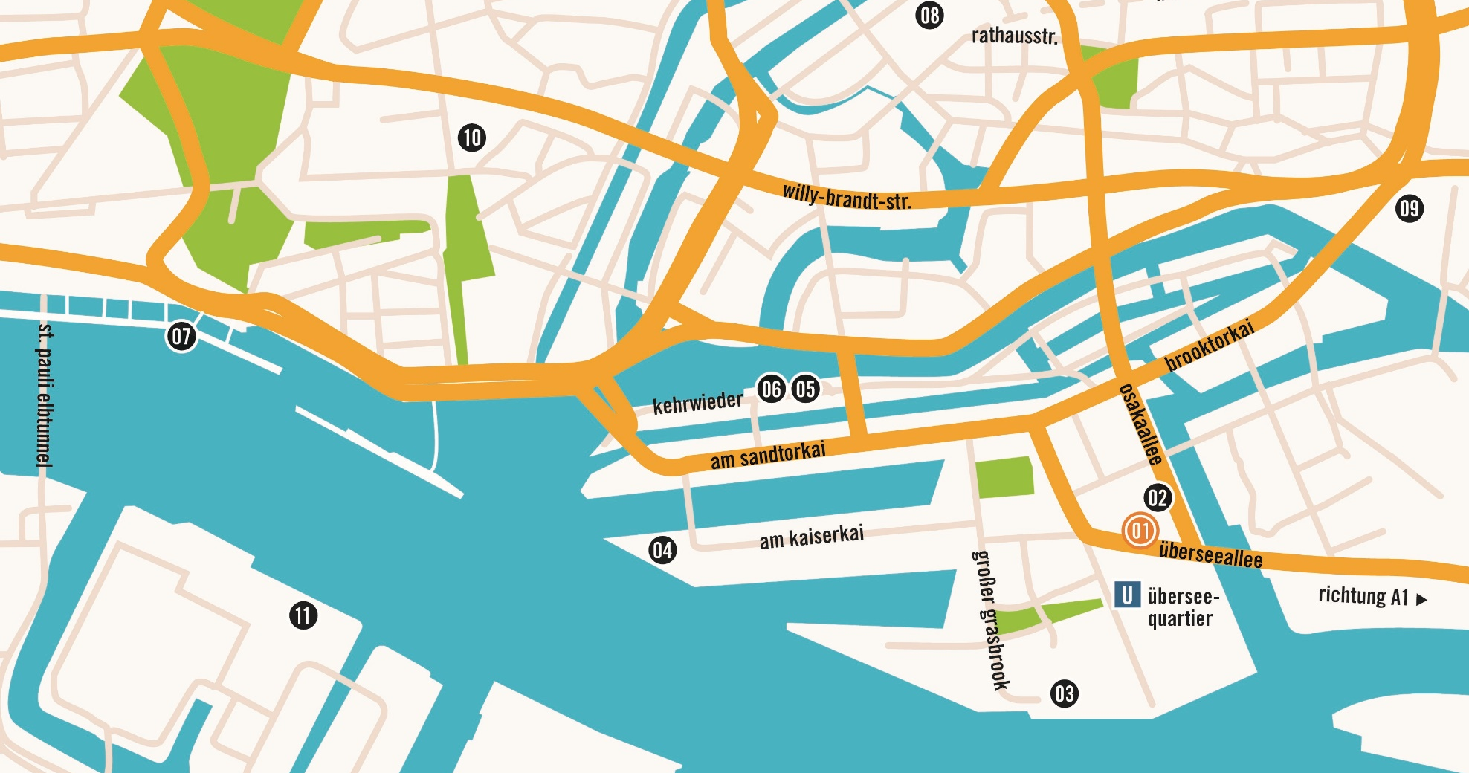
A girl in every port.
25hours hotel hafencity
25hours hotel hafencity
25hours hotel altes hafenamt
cruise center
elbphilharmonie
hamburg dungeon
miniatur wunderland
landungsbrücken
hamburger rathaus
deichtorhallen
hauptkirche st. michaelis
stage theater am hafen

Slide 4
facts & figures

Slide 5
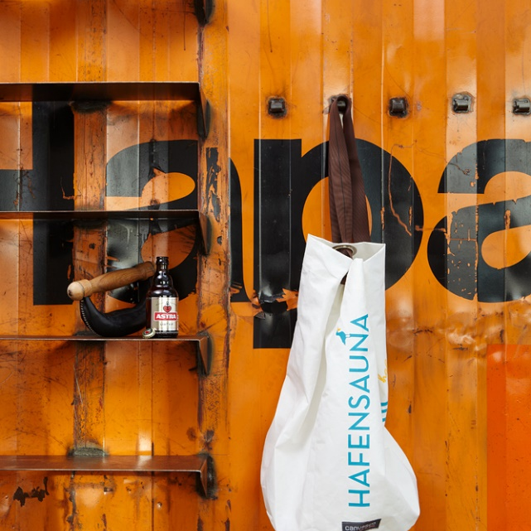
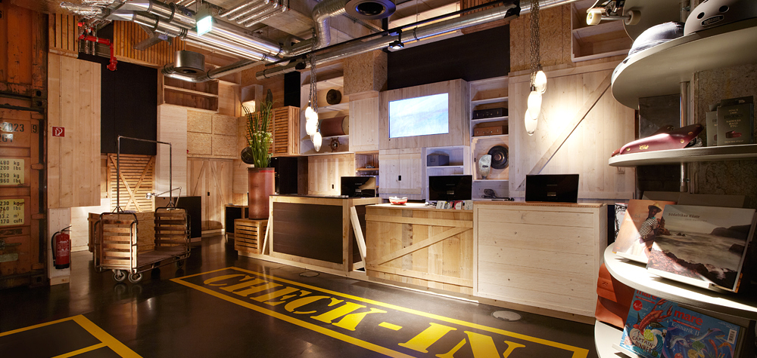
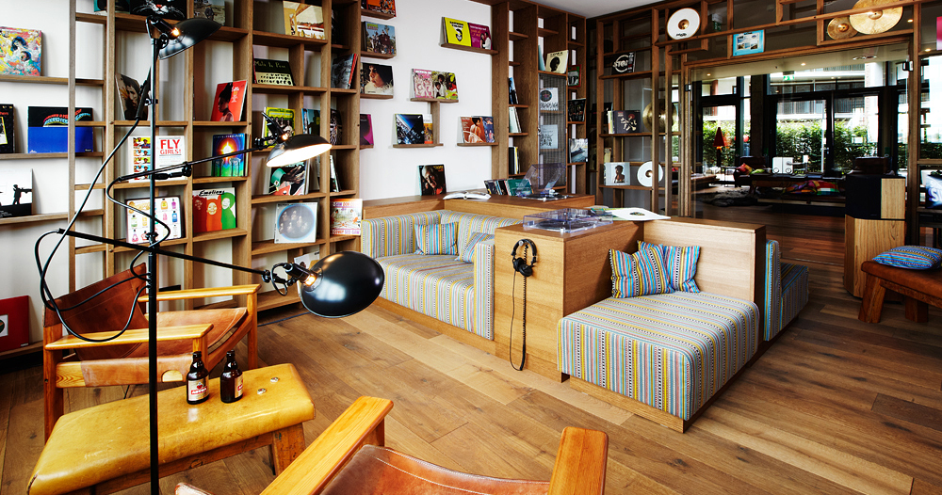
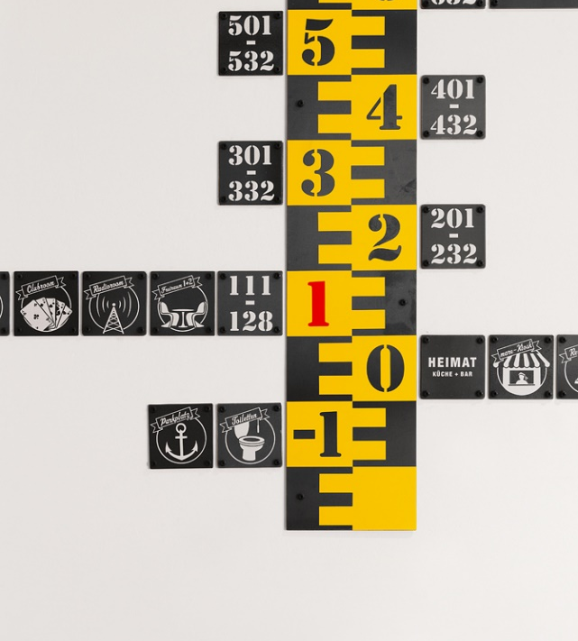
HafenCity
25hours hotel hafencity
Number of rooms
170
opening
July 2011
General manager
Patrick Moreira
Interior Design
Hamburg
Eventlabs, Conni Kotte, Stephen Williams Accociates, Markus Stoll
Restaurant
HEIMAT Küche + Bar, 100 seats
Meetings & Events
4 function rooms for up to 60 people, mare Gallery for up to 200 people
Facilities
underground parking · jogging corner · mare kiosk · harbour sauna · club floor with vinyl room

Slide 6
rooms

Slide 7
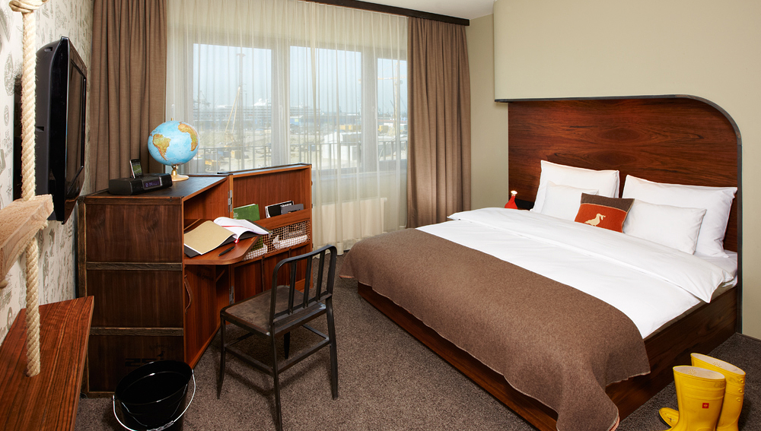
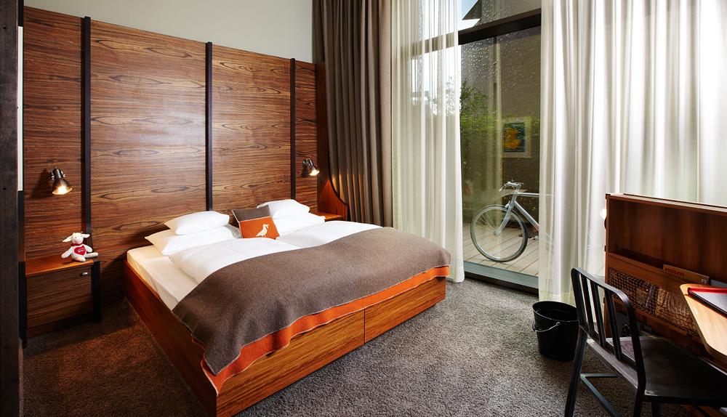
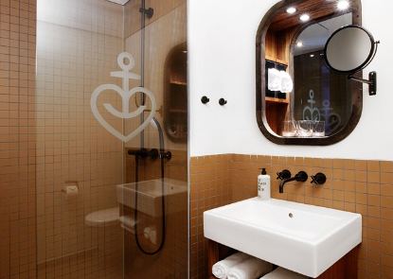
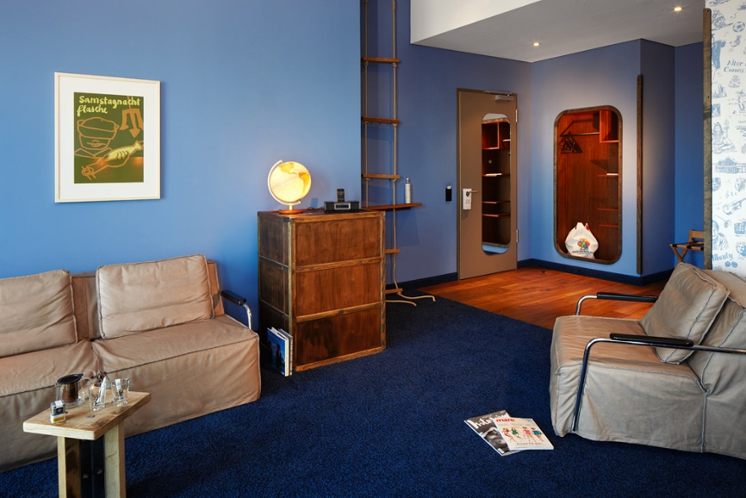
Let’s spend the night together.
25hours hotel hafencity
m cabin from eur 120
bunk bed from eur 120
m+ cabin from eur 130
l room from eur 140
Xl room from eur 170

Slide 8
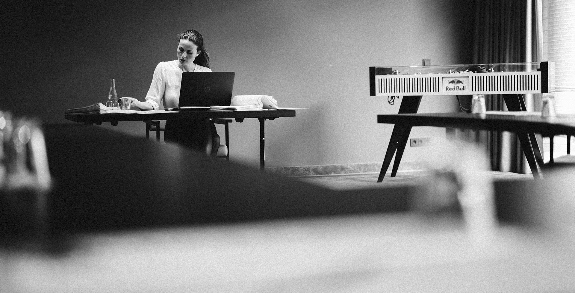
Almost home.
25hours hotel hafencity
air conditioning
high-speed wifi
minibar
ue boom bluetooth speaker
canvasco
bag
stop the water while using me! toiletries

Slide 9
restaurant & bar

Slide 10
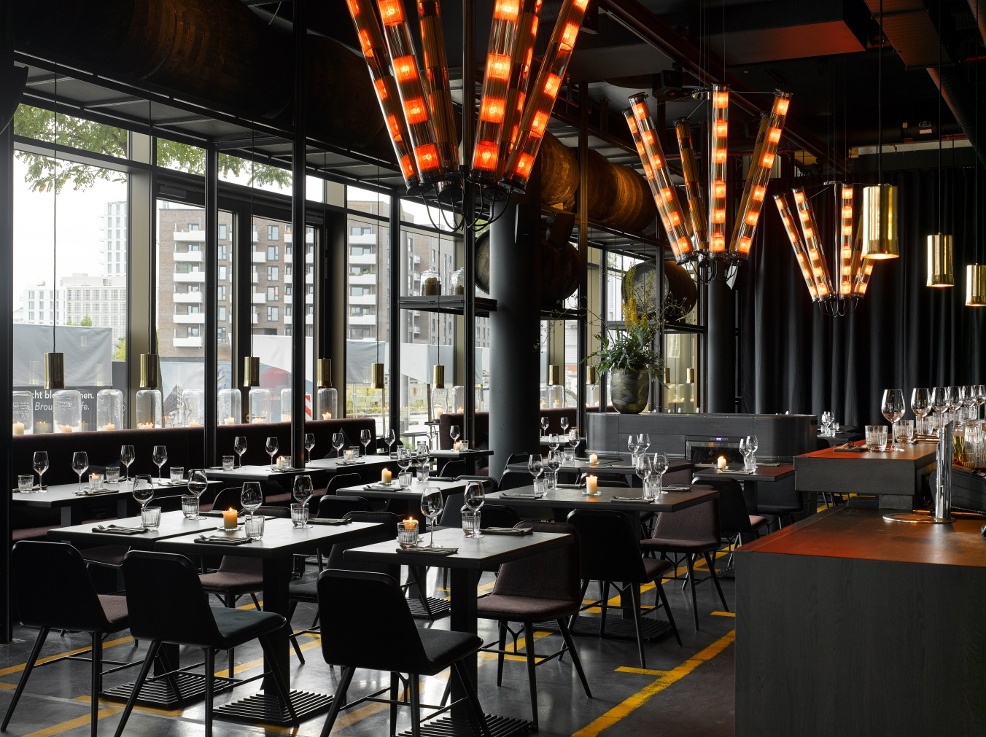

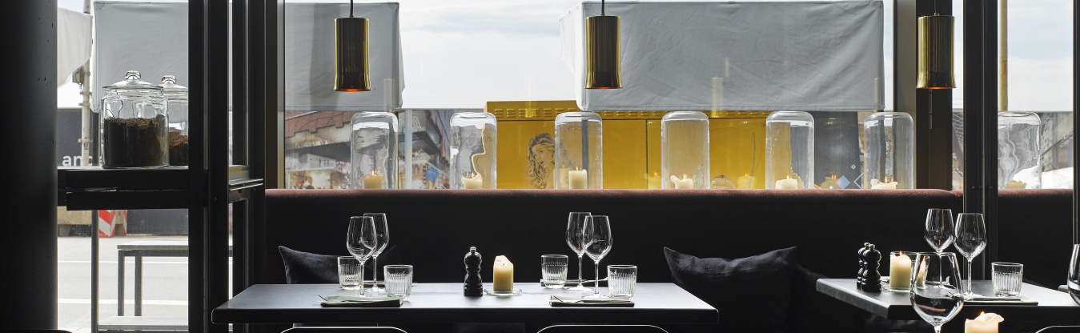
25hours hotel hafencity
The Restaurant heimat is the living room of Hamburg's HafenCity. A meeting place for hotel guests and locals alike. The menu welcomes everyone with popular classics and seasonal dishes created with locally sourced produce.
Key facts
warehouse and harbour atmosphere
100 seats
outside terrace
breakfast, lunch, after-work, late night

Slide 11
meetings & events

Slide 12
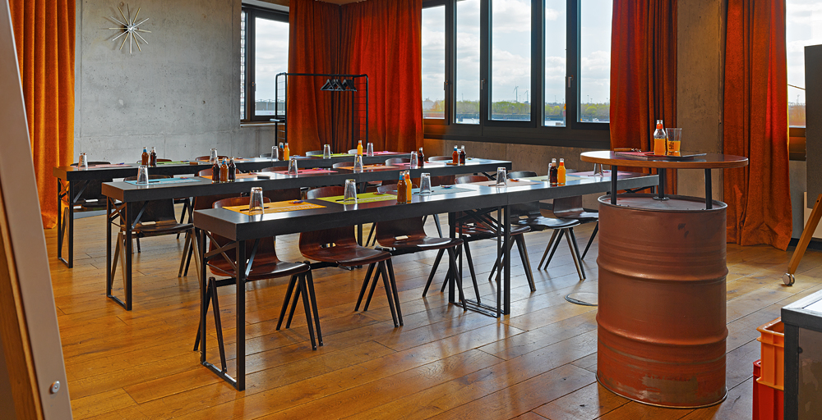
25hours hotel hafencity
Don’t act like you’re not impressed.
  freiraum 1
    75sqm for ~50 people
  freiraum 2
    40sqm for ~ 18 people
  freiraum 1+2
    115sqm for ~60 people
  freiraum 3
    40 sqm
  container
    25sqm for ~10 people
  gallery
    300sqm for ~ 90 people
Sit down and wait for superman.
  conferences up
  to 110 people
  events for up to 200 people
  contemporary infrastructure
  breakout-facilities throughout
  the public area
  meeting packages from eur 74 p.p. (full day)

Slide 13
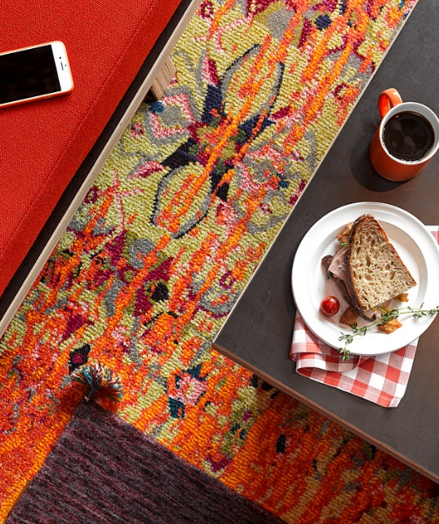
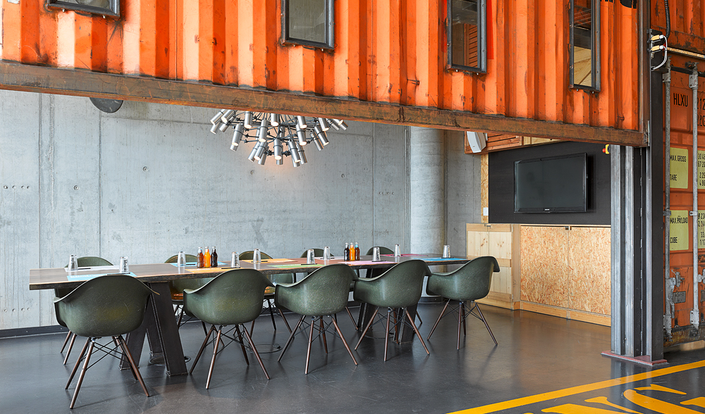
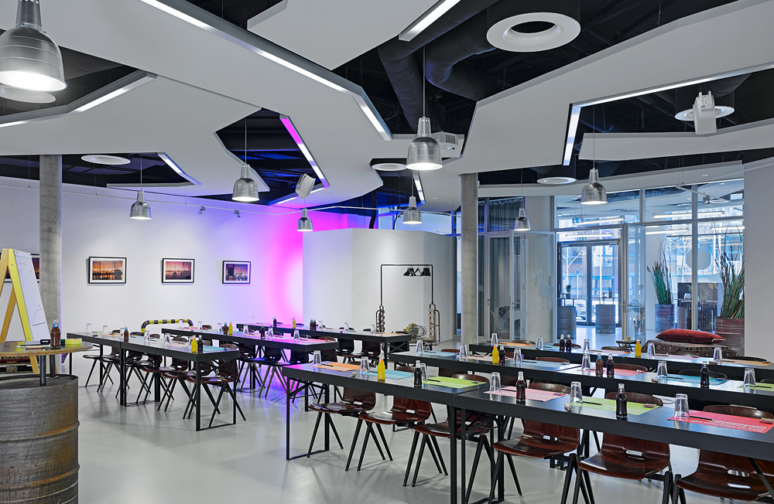
sit down and wait for superman.
25hours hotel hafencity
Freiraum
Gallery
Container

Slide 14
retail

Slide 15
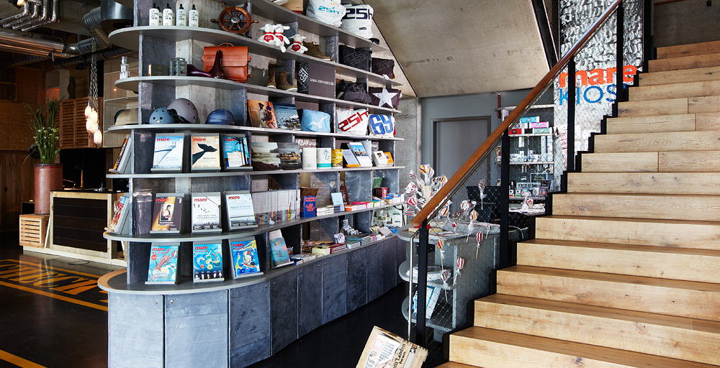
Mare kiosk
25hours hotel hafencity

Slide 16
sauna

Slide 17
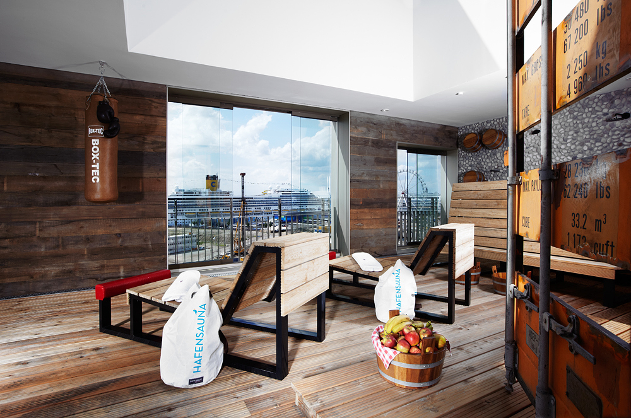

25hours hotel hafencity

Slide 18
urban mobility

Slide 19
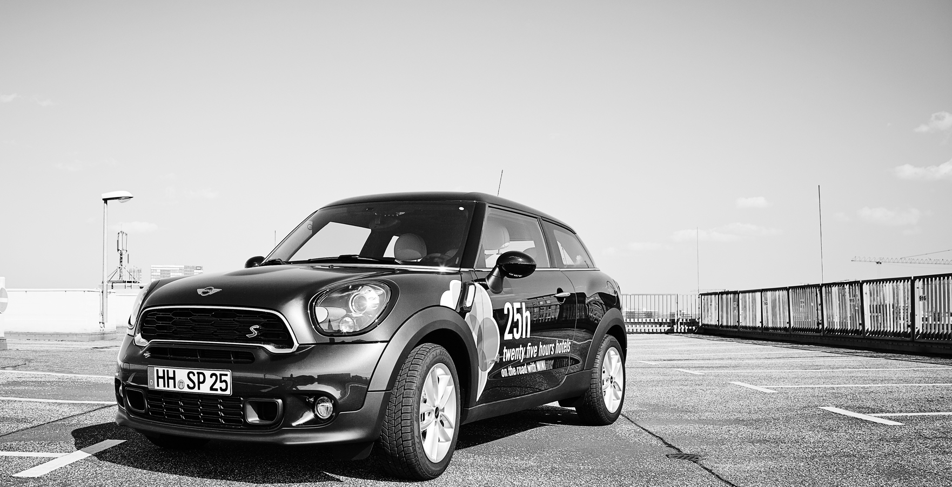
Free-of-charge mini rental
25hours hotel hafencity

Slide 20
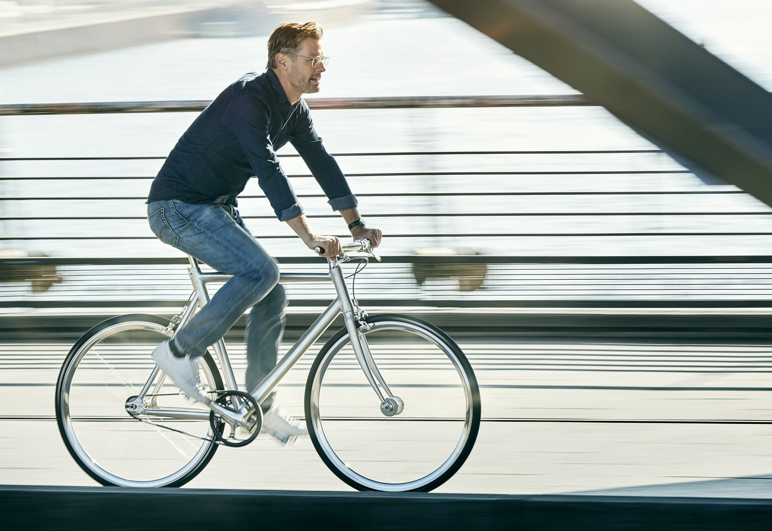
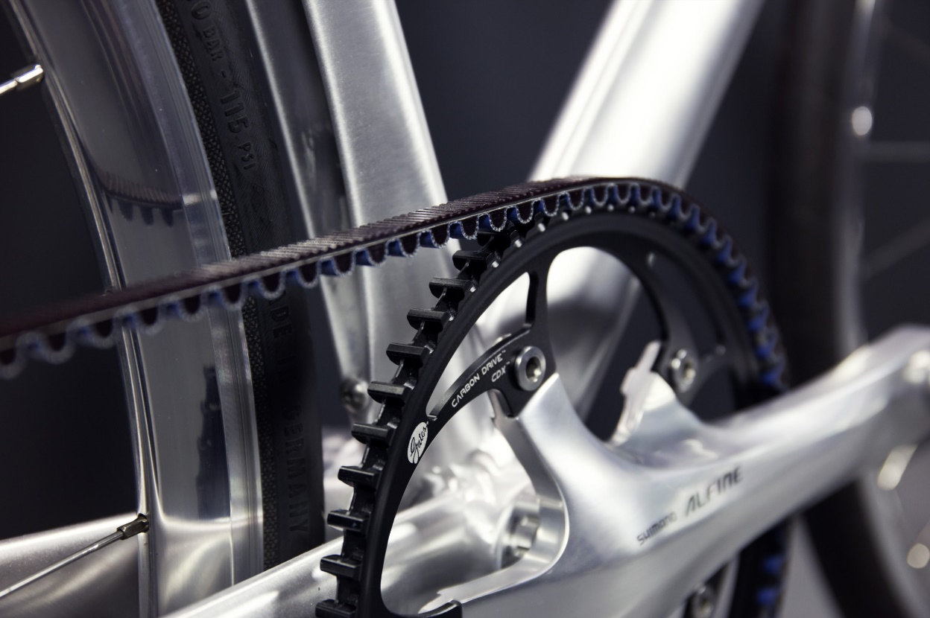
Schindel-hauer Bikes for rent
25hours hotel hafencity

Slide 21
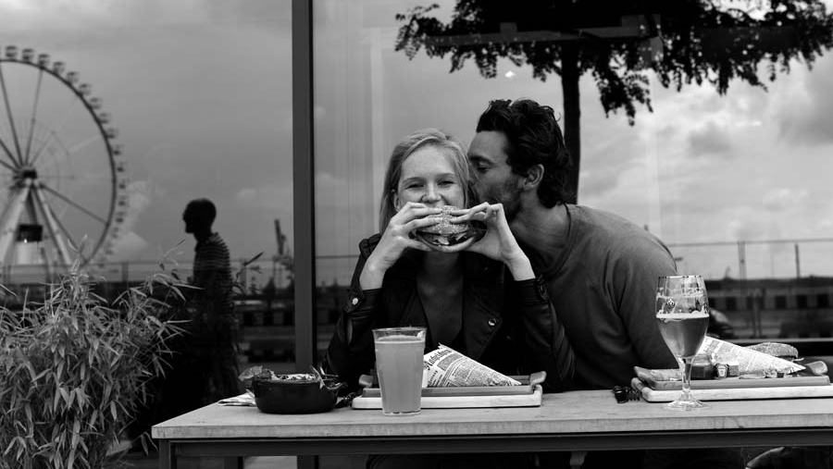
Thank you
25hours hotel hafencity
  überseeallee 5
  20457 hamburg
  p +49 25 7777 0
  hafencity@25hours-hotels.com

