Slide 1
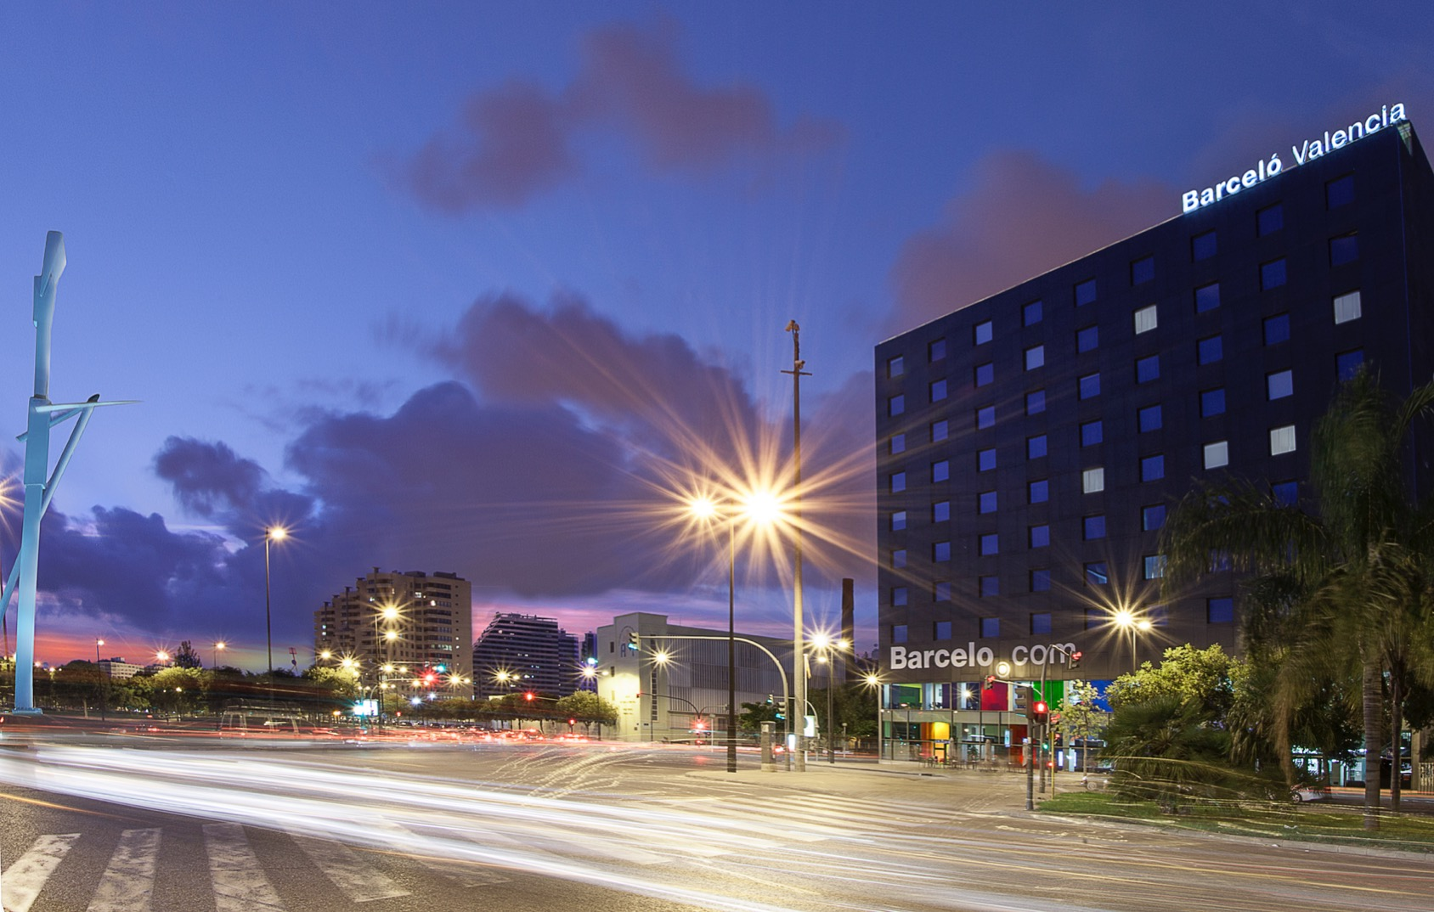




Slide 2
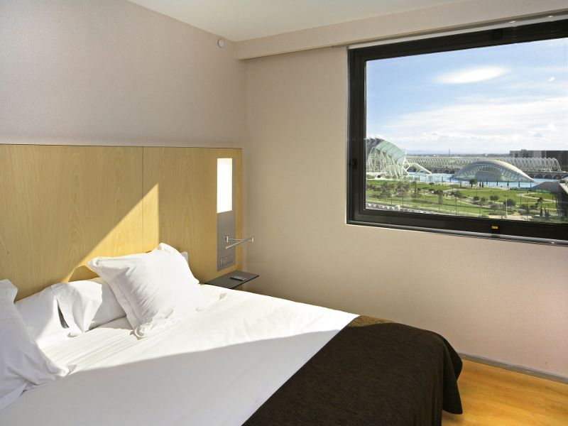

Facilities and services
Panoramic views Gym 270º rooftop bar 270º swimming pool Parking “270º Terrace” for coffee breaks and cocktails Versatile foyer Restaurant and snack bar Wellness centre in the attic Complimentary Wi-Fi

Slide 3
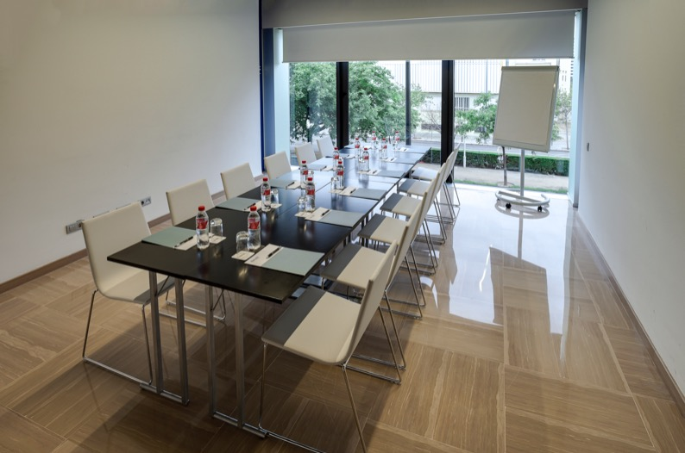
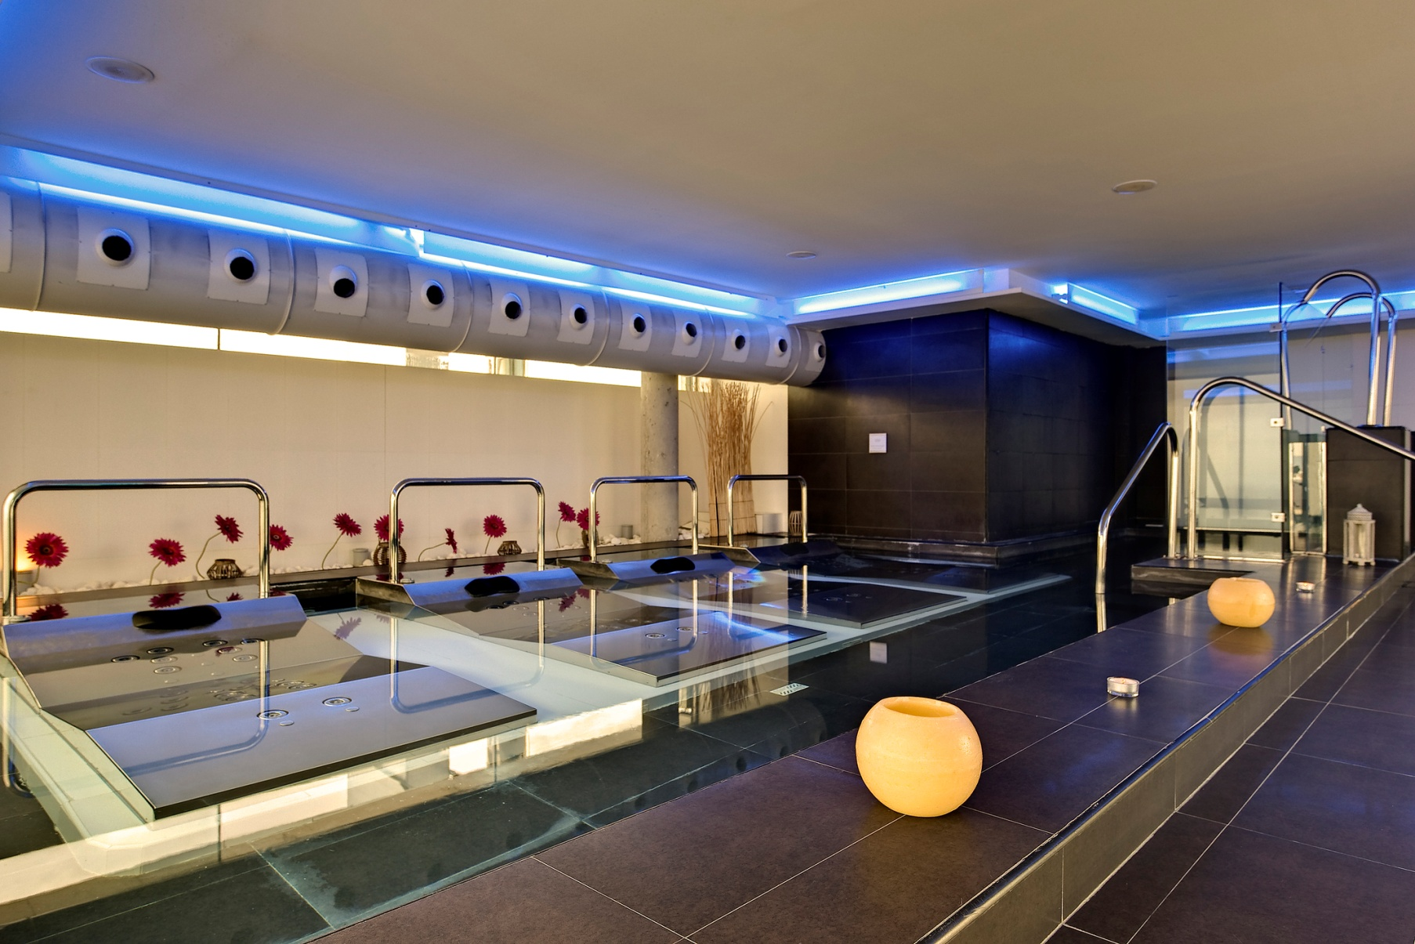
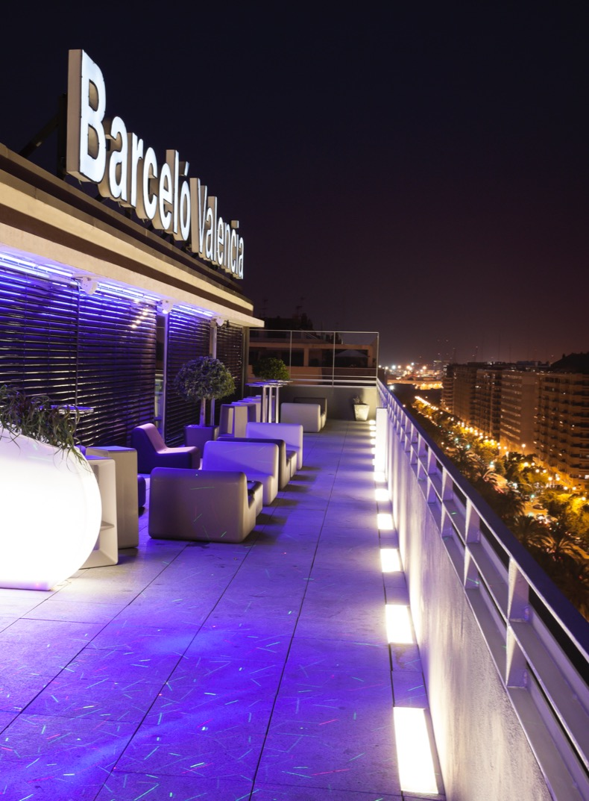
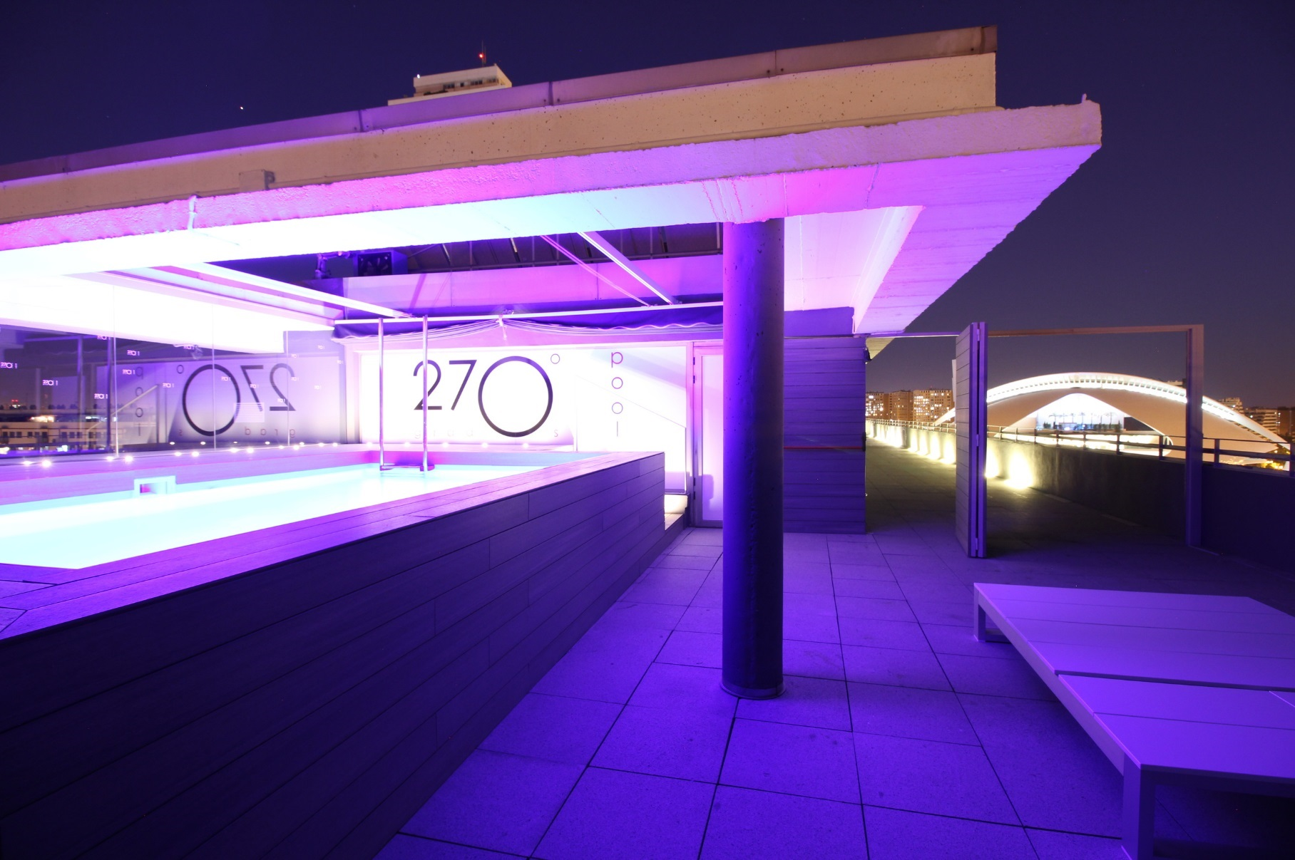
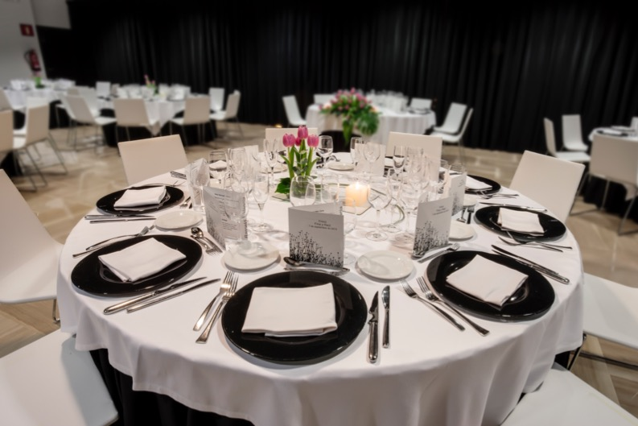

Slide 4
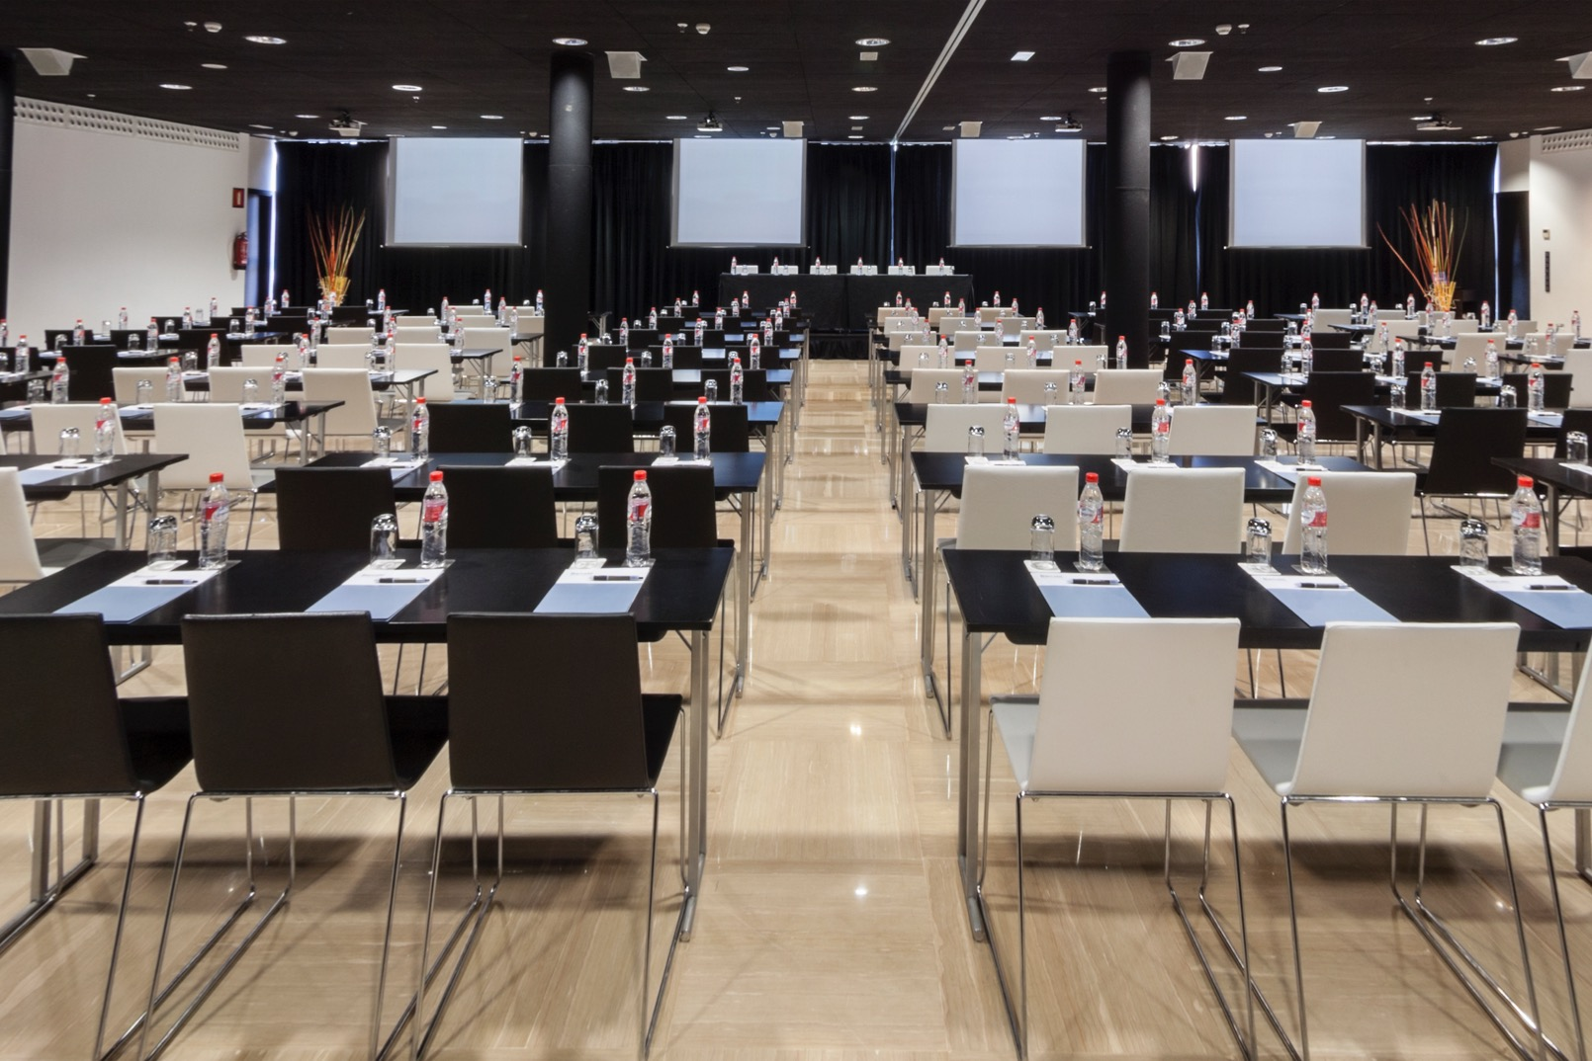
Capacity and location
187 rooms Meeting rooms for up to 350 people 8 km from Manises airport, Valencia 2 km from Playa de las Arenas 2 km from city centre 100 m from Ciudad de las Artes y las Ciencias museum 2.5 km from Joaquín Sorolla AVE train station

Slide 5
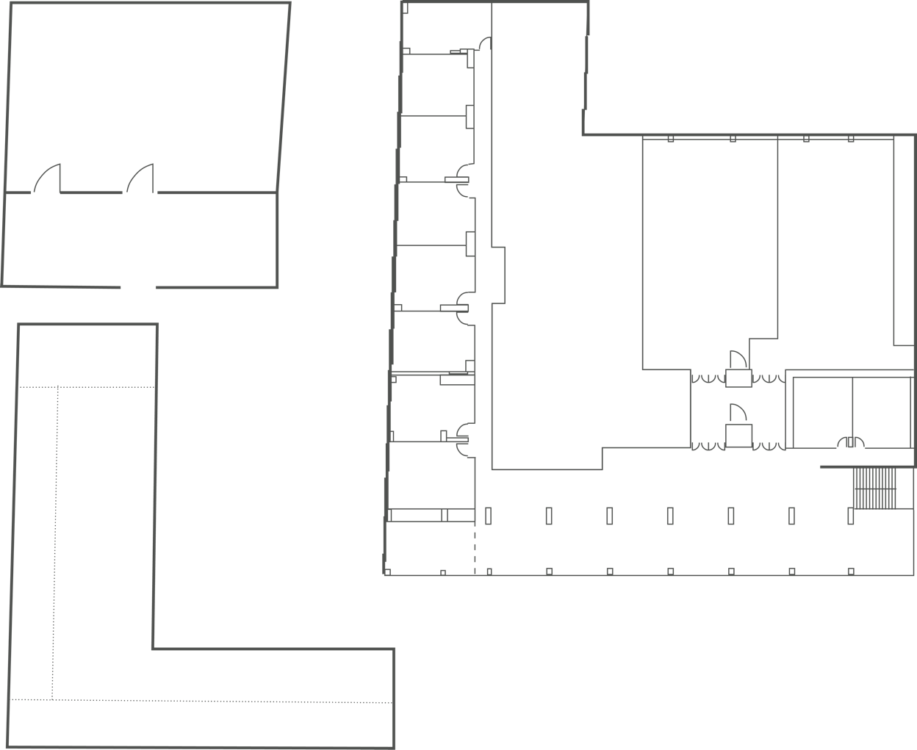
Meeting rooms
Themed meetings Car exhibitions Daylight Wi-Fi
Terrace
130 m²
Rubí
25 m²
Lima
26 m²
Marino
27 m²
Taronja
65 m²
Celeste I
170 m²
Celeste II
200 m²
Melocotón
27 m²
Terrace
111 m²
Púrpura
29 m²
Mandarina
29 m²
Burdeos
35 m²
Foyer
315 m²
Terrace
104 m²
Marengo
33 m²
Terrace
136 m²

Slide 6

MEETING ROOM | SURFACE (SQ M | SQ FT) | HEIGHT (M | FT) | NATURAL LIGHT | BANQUET | COCKTAIL | CLASSROOM | THEATRE | U-SHAPE | H-SQUARE | BUFFET
CELESTE I | 170 | 1,829.9 | 3 | 9.8 | Yes | 120 | 160 | 100 | 150 | 40 | 50 | 72
CELESTE II | 200 | 2,152.8 | 3 | 9.8 | Yes | 130 | 160 | 110 | 160 | 40 | 50 | 78
CELESTE I+II | 370 | 3,982.6 | 3 | 9.8 | Yes | 250 | 320 | 230 | 330 | 70 | 75 | 150
MARENGO | 33 | 355.2 | 4 | 13.1 | Yes | 18 | 20 | 15 | 24 | 15 | 12 | 9
BURDEOS | 35 | 376.7 | 3 | 9.8 | Yes | 20 | 25 | 21 | 30 | 18 | 12 | 7
MANDARINA | 29 | 312.2 | 3 | 9.8 | Yes | 20 | 25 | 18 | 24 | 15 | 12 | 6
PÚRPURA | 29 | 312.2 | 3 | 9.8 | Yes | 20 | 22 | 18 | 24 | 15 | 12 | 7
MARINO | 27 | 290.6 | 3 | 9.8 | Yes | 18 | 22 | 18 | 24 | 15 | 12 | 7
MELOCOTÓN | 27 | 290.6 | 3 | 9.8 | Yes | 18 | 22 | 18 | 24 | 15 | 12 | 7
LIMA | 26 | 279.9 | 3 | 9.8 | Yes | 18 | 20 | 18 | 20 | 15 | 12 | 7
RUBÍ | 25 | 269.1 | 3 | 9.8 | Yes | 18 | 20 | 18 | 24 | 15 | 12 | 6
TARONJA | 65 | 699.7 | 3 | 9.8 | Yes | 40 | 60 | 30 | 45 | 21 | 28 | 21
FOYER | 316 | 3,401.4 | 4 | 13.1 | Yes | 190 | 350 | 170 | 267 | - | 80 | 82
TERRAZA 270º | 351 | 3,778.2 | - | Yes | - | 250 | - | - | - | - | -

Slide 7


